Slide 1
Lancaster University

Slide 2
Location

Slide 3
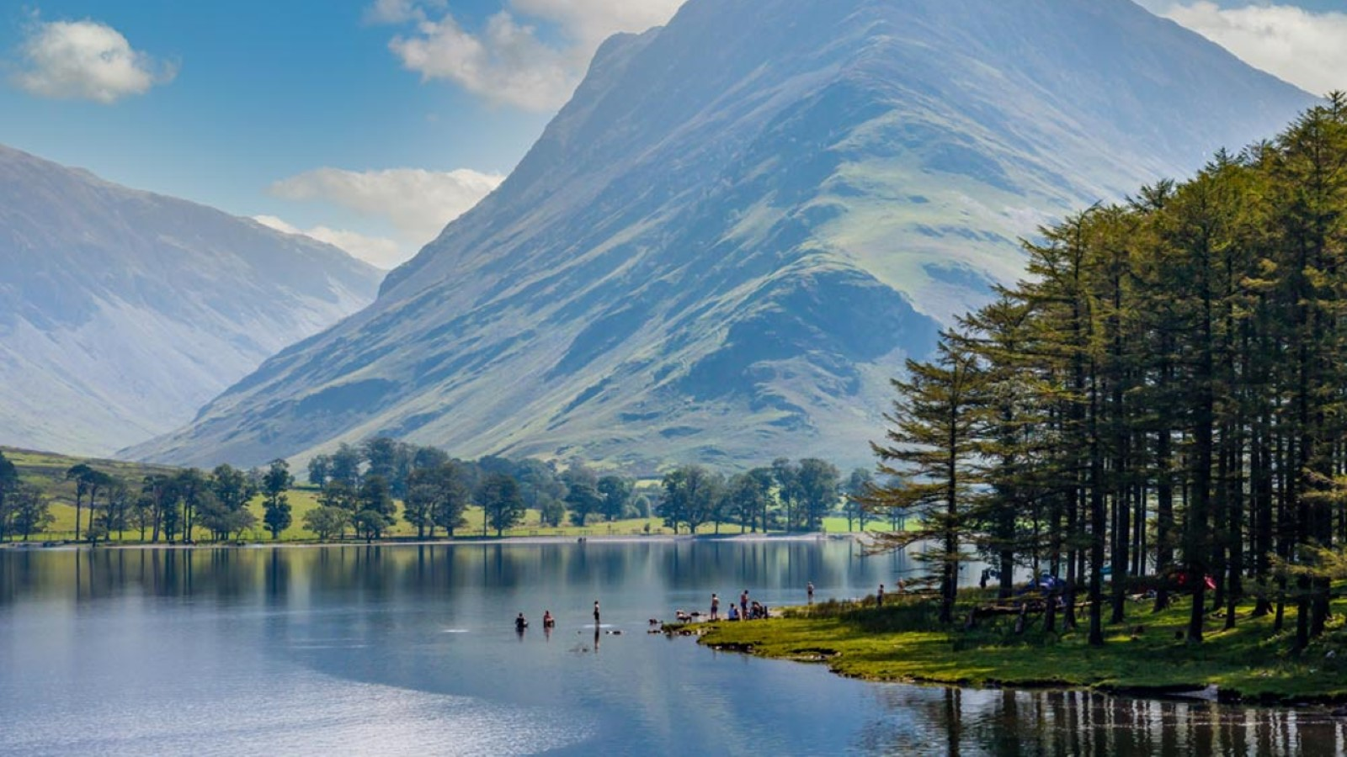

Slide 4
Lancaster City

Slide 5
Lancaster University Campus

Slide 6
Campus Facilities

Slide 7
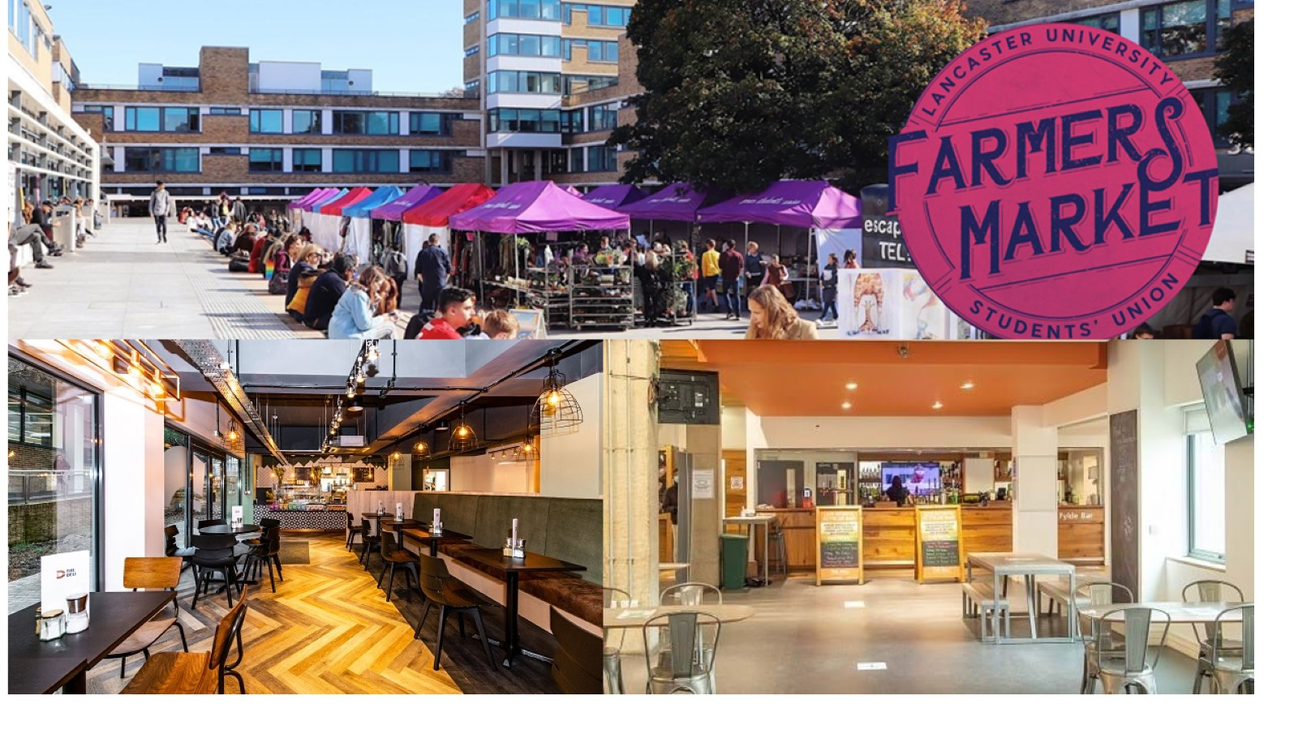

Slide 8
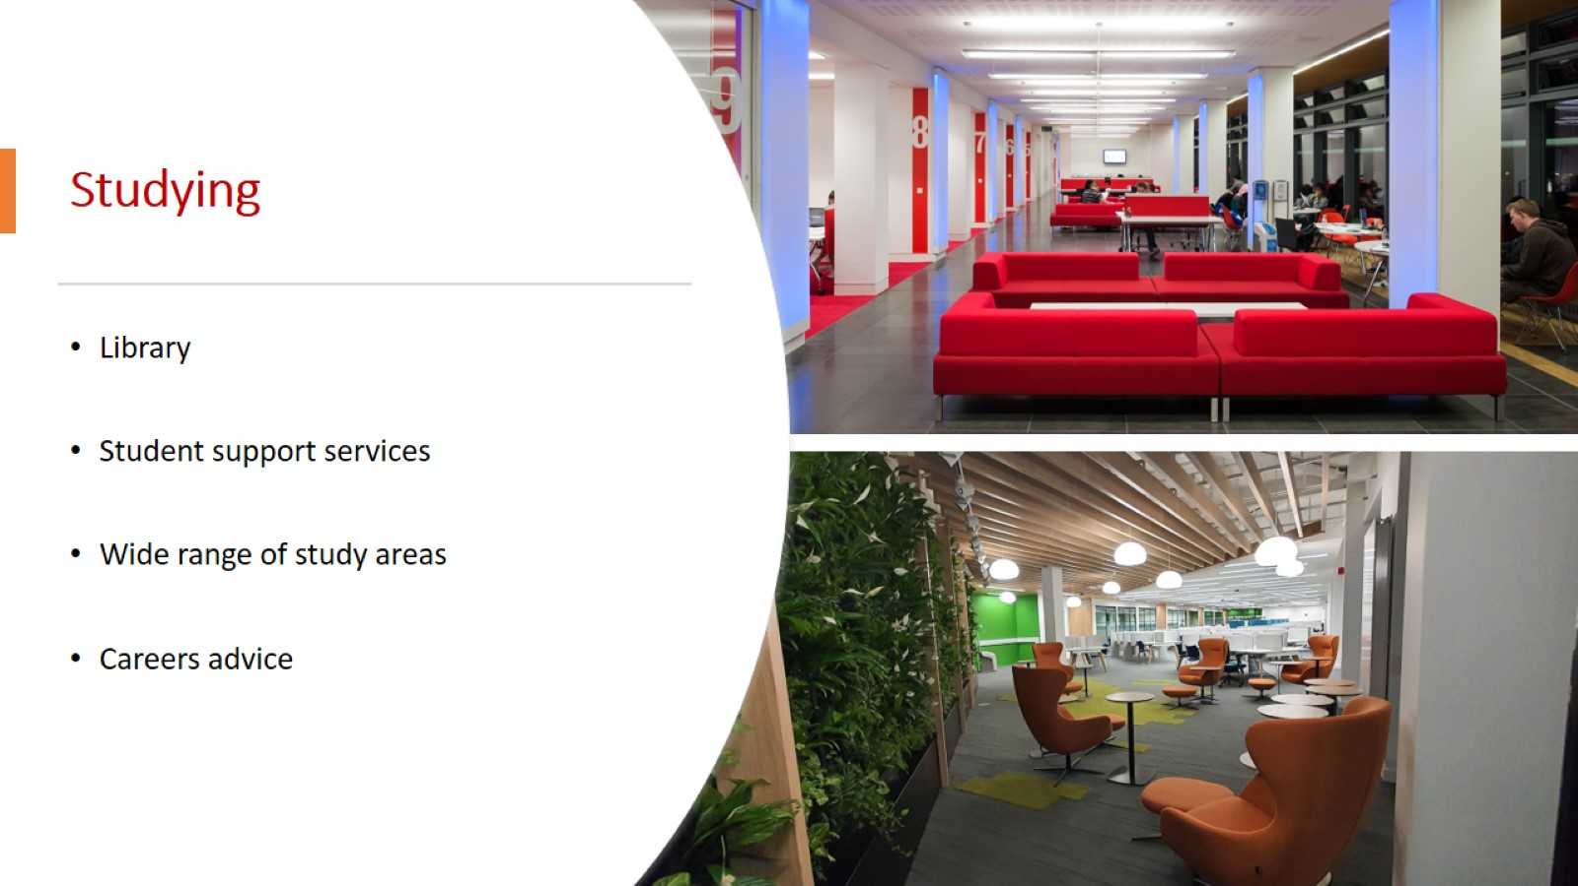
Studying

Slide 9
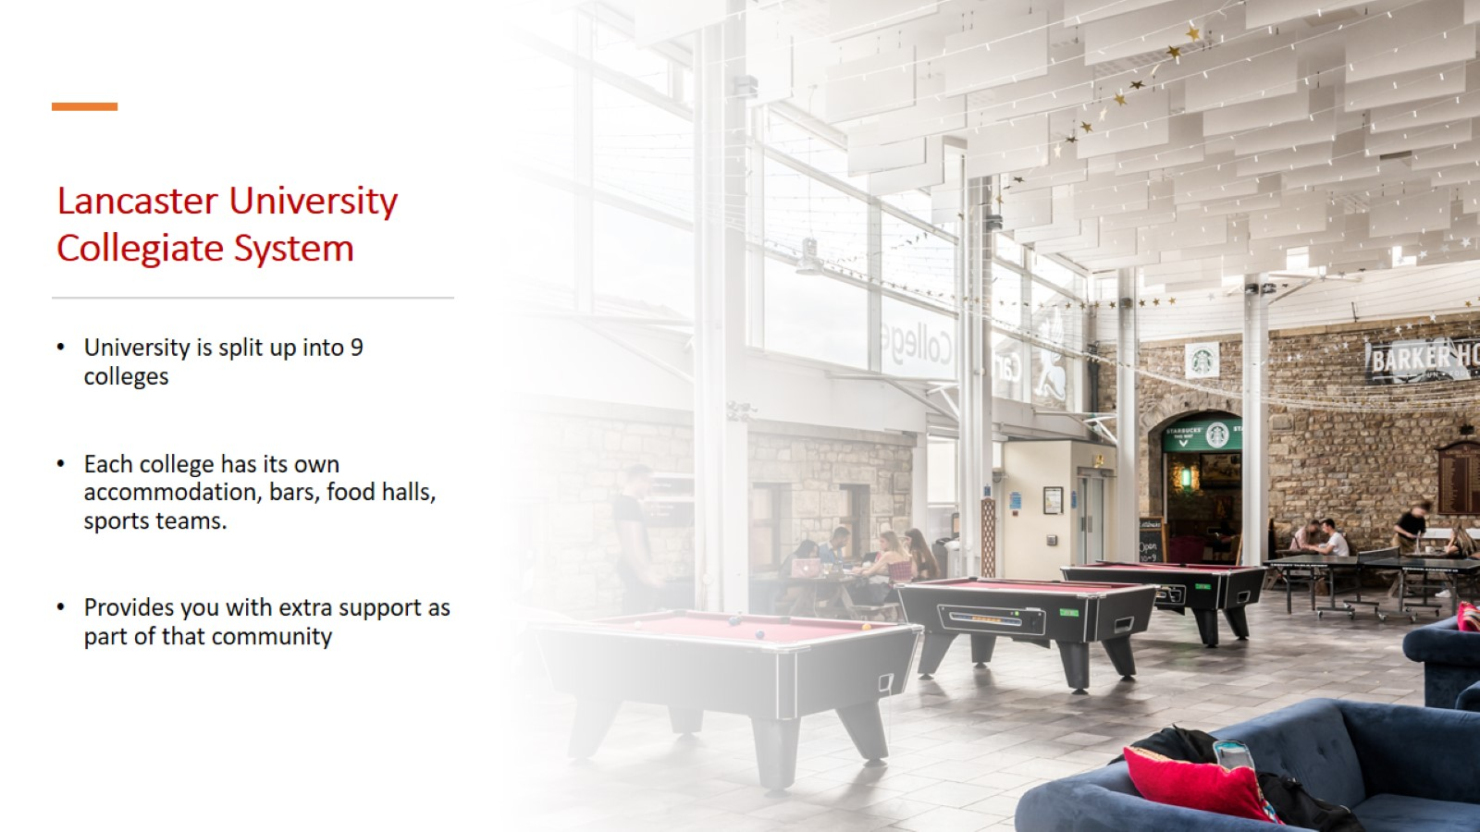
Lancaster University Collegiate System

Slide 10
Thankyou for listening!

